Slide 1
Video Anomaly Detection and Classification for Autonomous Deep-Space Robotics
Rohaan Ahmed
Mission Systems Engineer, MDA Space
PhD Computer Science (Student), LIA Lab, Ryerson University
15 December 2020

Slide 2
Motivation & Problem Statement
Dataset and Data Engineering
Unsupervised Model
Model Architecture
Model Training & Evaluation Metric
Model Testing
Supervised Classification
Results & Future Work
Content

Slide 3
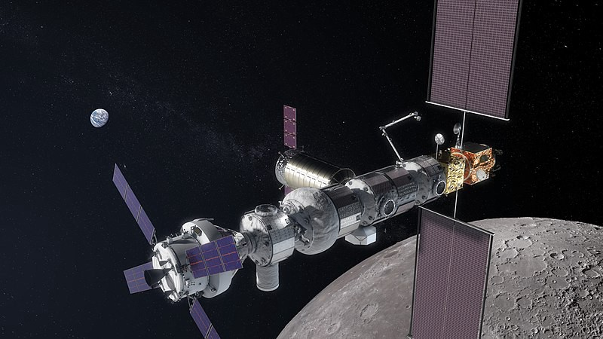
Motivation
The Space industry is seeing rapid growth, with a focus on colonizing the Moon, Mars, and beyond.
Robotic systems operating in deep space will require high levels of autonomy
Autonomous Operation
Maintenance
Self repair
Navigating unexpected situations
One such large program is the upcoming Lunar Gateway
Lunar Orbital Platform Gateway (LOP-G) (Courtesy: NASA)

Slide 4
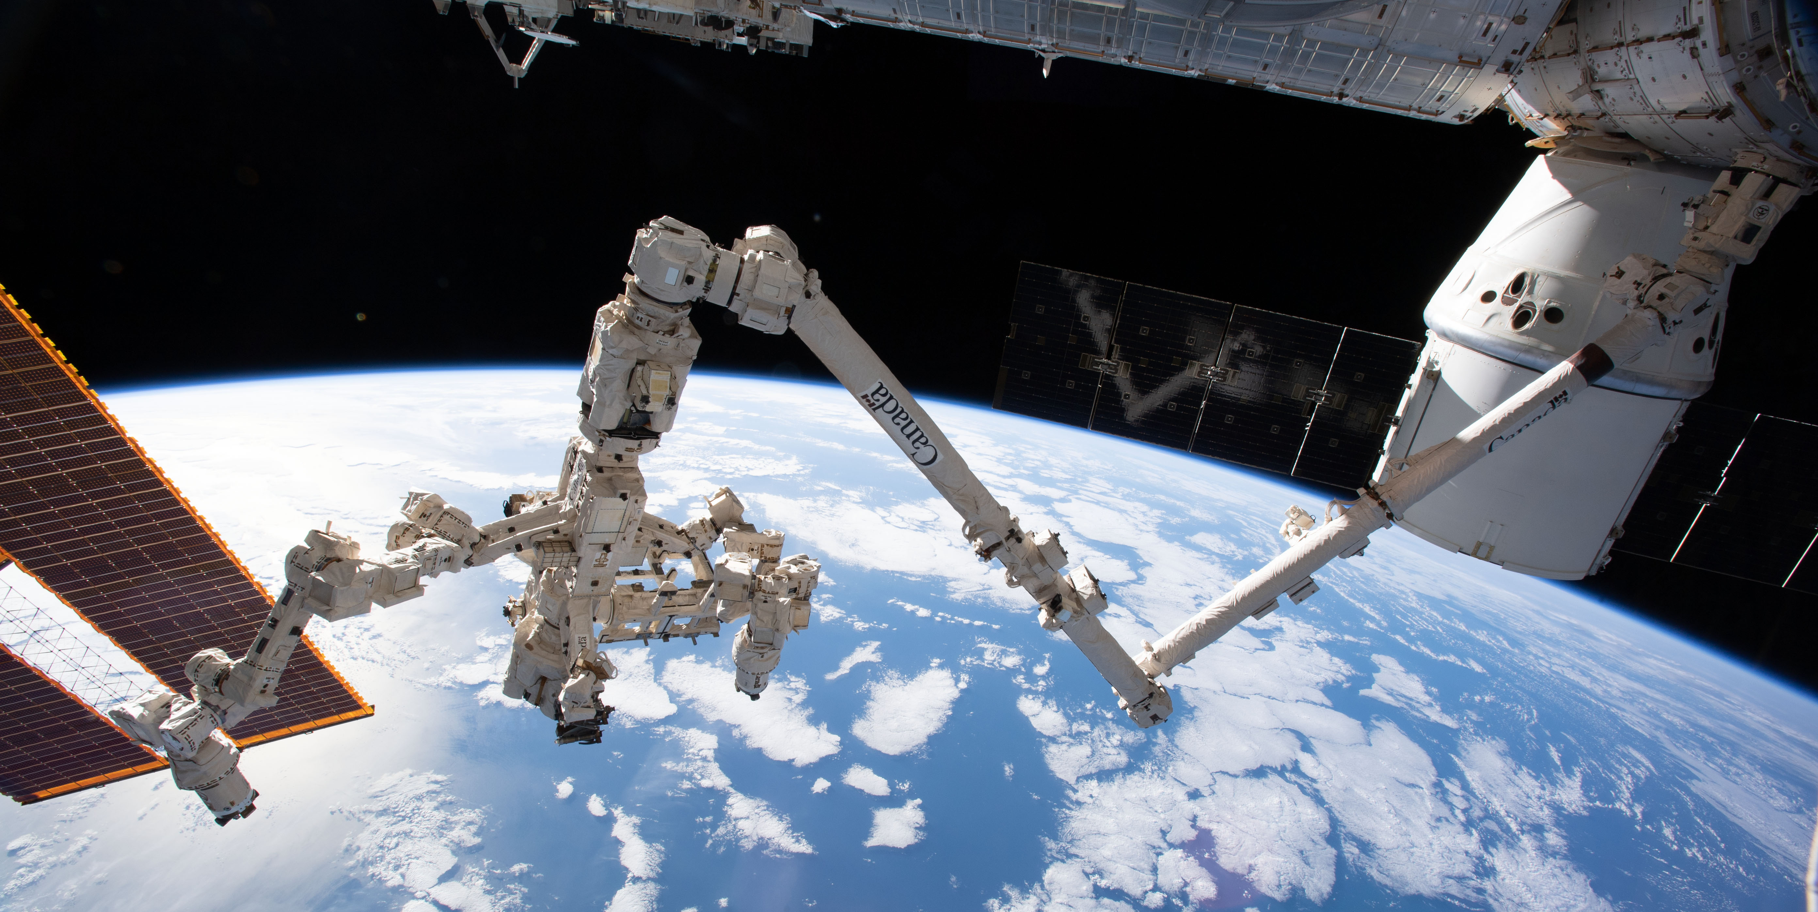
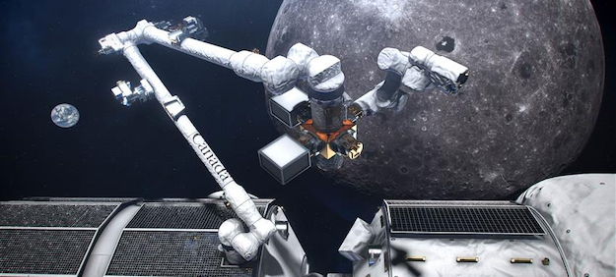
Canadarm3 and Lunar Gateway
Canadarm3 will be Canada’s contribution to the Lunar Gateway
Similar to Canadarm2, it will be used for:
Construction
Maintenance
Inspection
Capture of visiting spacecraft
Module relocation
Support of spacewalks.
Unlike Canadarm2, it will need to be fully autonomous
Comm Delays and Dropouts
Bandwidth Limitations
Canadarm2 on the International Space Station (Courtesy: CSA)
Canadarm3 Concept Image (Courtesy: CSA)

Slide 5
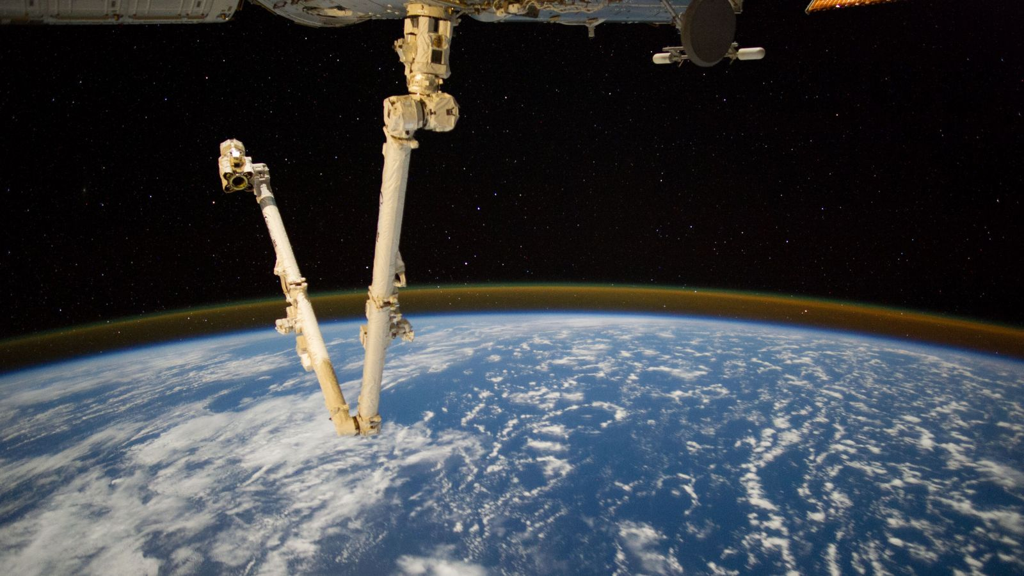
Project Objective
Develop Proof of Concept AI-enabled Video Anomaly Detection and Classification system
Input: In-space videos generated on-board
Output: Video-clips classified as Anomalous or Non-Anomalous

Slide 6
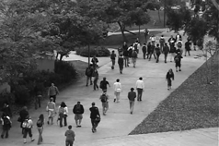
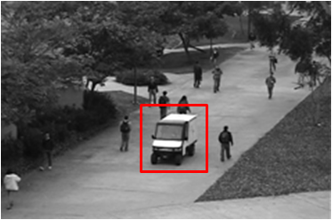
Dataset & Data Engineering
Non-Anomalous Frame
UCSD Anomaly Detection Dataset
Use UCSD Dataset as surrogate for difficult to obtain Space Datasets
UCSD Dataset is consists of 34 Train and 36 Test videos, 200-frames each.
Acquired with a stationary camera mounted at an elevation, overlooking pedestrian walkways with variable crowd densities.
Train Videos: “Normal” conditions only, ex. pedestrians walking
Test Videos: “Abnormal” events only, ex. carts
Perform Data Augmentation to generate “new” video sequences from existing data, using strides
Anomalous Frame
Video Frames from the UCSD Dataset (Courtesy: UCSD)

Slide 7
Anomaly Detection (Unsupervised)
Anomaly Classification
Convolutional Long Short-Term Memory (LSTM) Autoencoder
Supervised XGBoost (Supervised) vs Simple Linear Threshold

Slide 8
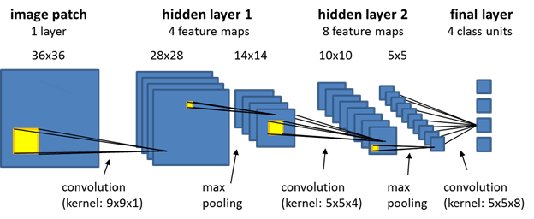
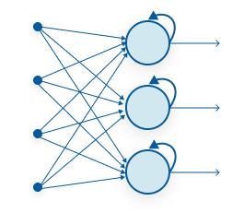
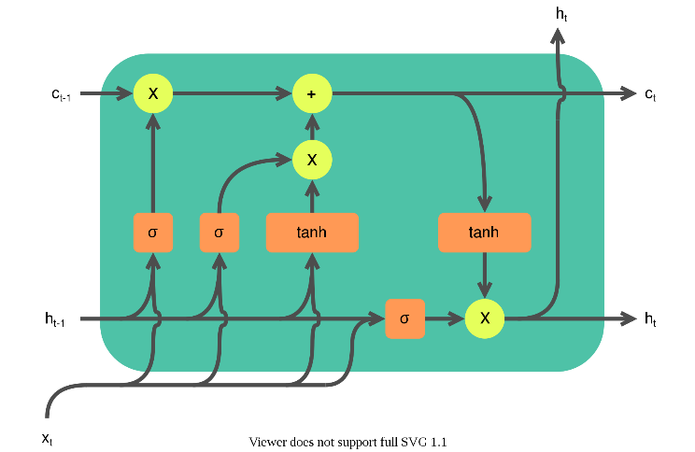
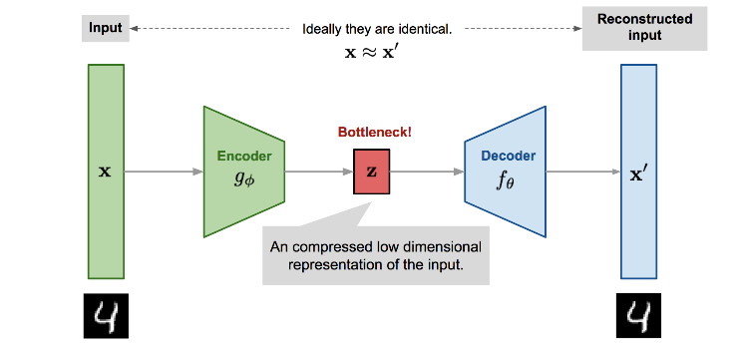
Unsupervised Learning Model
Convolutional Long Short-Term Memory (LSTM) Autoencoder
Use Unsupervised Machine Learning to reconstruct input images
Combine well-known architectures:
Convolutional Neural Networks (CNN): To extract Spatial Features from input image
Convolutional LSTM RNN: To extract Spatial and Temporal Features from input sequences
Autoencoder: To re-construct input images as best as possible, using only embedded feature maps
Reconstruction Score: A metric that measures the “confidence” of the reconstructed image

Slide 9
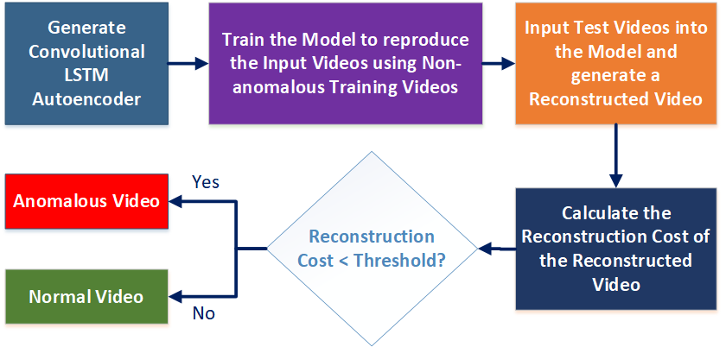
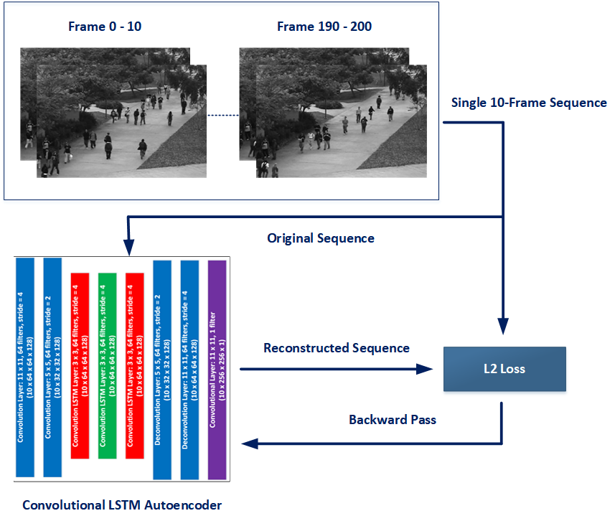
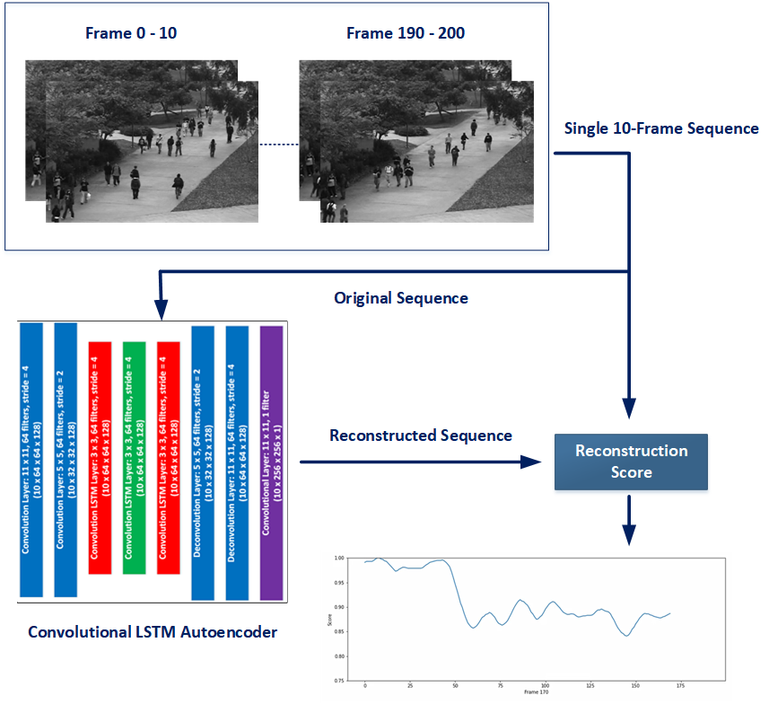
Model Training & Inference ConOps
Training
Inference
Train the Model ONLY on Non-anomalous data
By doing so, we expect the Reconstruction Score (i.e., confidence) to be:
LOW for Anomalous Data
HIGH for Non-anomalous Data
Use this metric to Classify the video

Slide 10
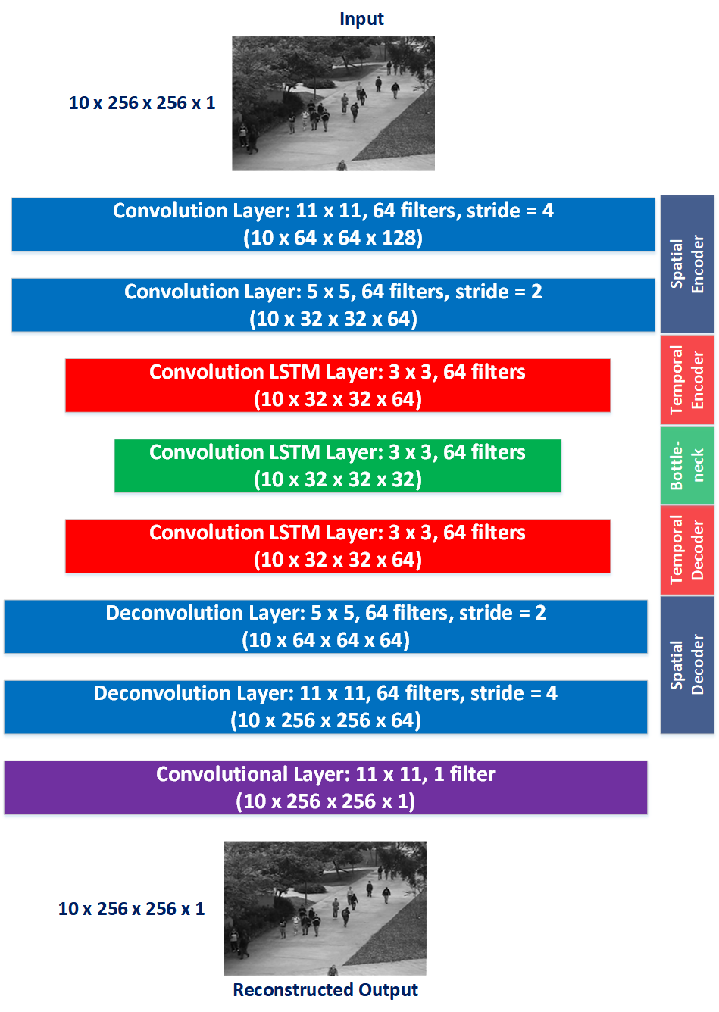
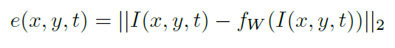
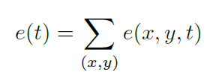
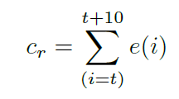
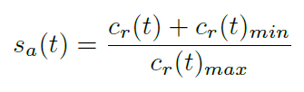
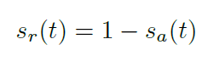
Convolutional Long Short-Term Memory (LSTM) Autoencoder
Reconstruction Score Calculation
Individual Pixel Errors
Sum of Errors
Sum of Errors for 10 frames
Normalized Sum of Errors
Reconstruction Cost

Slide 11
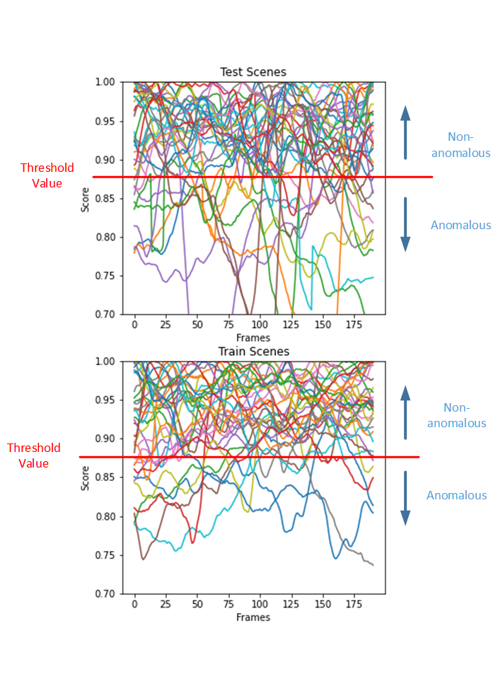
Anomaly Classification
Reconstruction Score plots reveal no obvious boundary for Anomalous vs Non-anomalous data
Two approaches for Classification of Reconstruction Score vectors:
Simple Linear Threshold:
Find Threshold Value that provides “optimal” accuracy, despite some mis-classifications
Able to obtain 70% Accuracy with Threshold at 0.875
Supervised Learning using XGBoost:
Use Random-Forest Ensemble Tree-based method to “learn” how to Classify the data
With 90-10 Train-Test split, obtain an accuracy of 50% -> Might as well toss a coin!
Reason: 70 data-points (34 Train + 36 Test) is insufficient to train an ML model for 190 features

Slide 12
Results & Conclusion

Slide 13
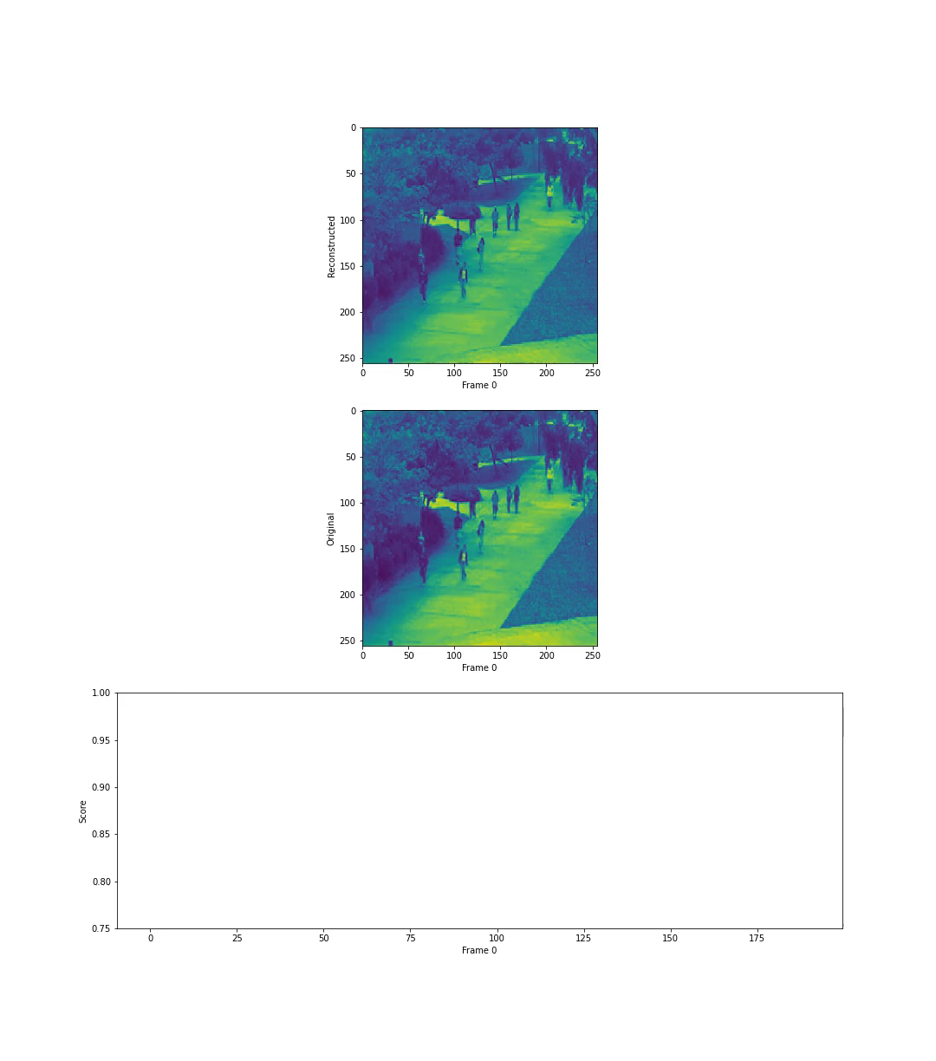
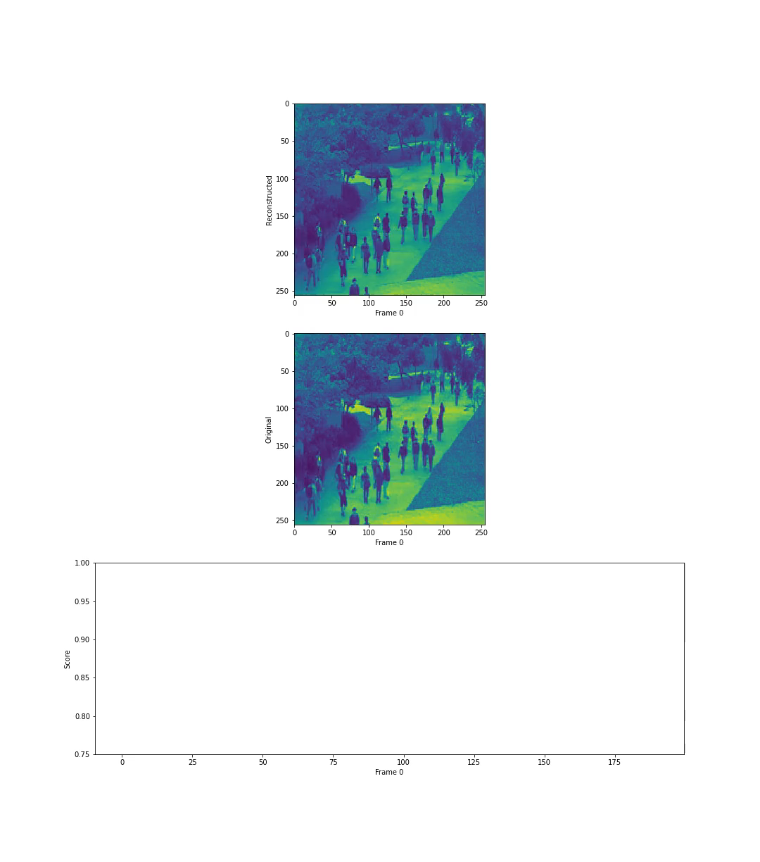
Sample Cases
Anomalous Case
Non-Anomalous Case
Unsupervised Model performs well
For all anomalous cases, able to determine when anomalous data
Anomalies are indicated by sharp change (drop) in Reconstruction Score
The task of Classification remains difficult
Future Work:
Improve Unsupervised Model
Find accurate Classifier
Transform for Synthetic Space Data

Slide 14
Video Anomaly Detection and Classification for Autonomous Deep-Space Robotics
Rohaan Ahmed
Rohaan.Ahmed@Ryerson.ca
Github.com/rohaan-ahmed

